Slide 1
Scaffold analytics figures to modify with chemical structures
Deepak Bandyopadhyay
Rajarshi Guha
Constantine Kreatsoulas

Slide 2
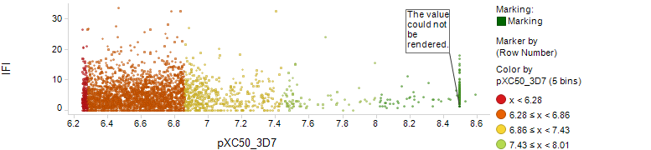
Fig2a

Slide 3
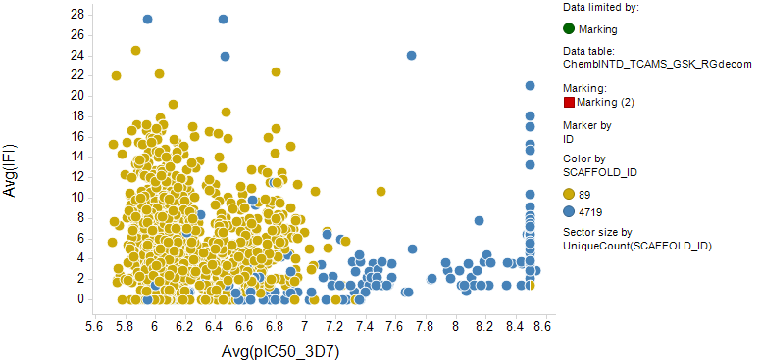
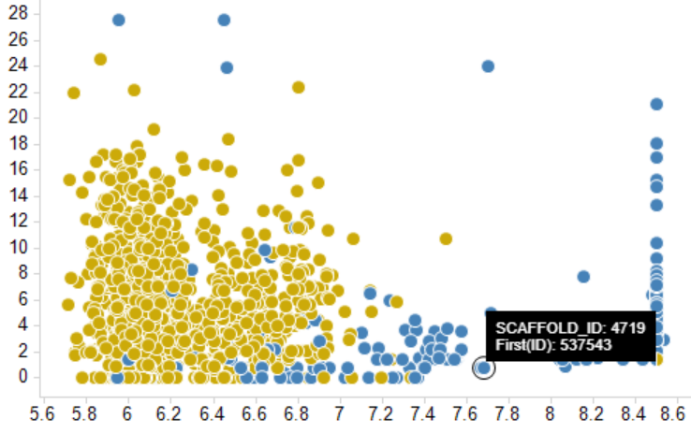
Fig2a bottom

